Slide 1

Respirator Training
NEPMU-6

Slide 2
Reference
OPNAVINST 5100.19E, Chapter B6
OPNAVINST 5100.23G, Chapter 15

Slide 3
Respirator Classes
Air Purifying
  Remove air contaminants by filtering, absorbing, or adsorbing as air passes through a filtering mechanism
Supplied Air
  Used when:
    Contaminant has no warning properties
    Concentrations too high for APR
    Environment is Immediately Dangerous to Life or Health (IDLH)
SCBA
Notes:
Why do we care what kind of respirator we use? One supplies oxygen, the other doesn’t (kind of important)

Slide 4
Air Purifying Respirators
Disposable

Slide 5
IDLH
Immediately Dangerous to Life or Health
  Oxygen deficiency
  Lethal concentrations of toxic gases
Caused by
  Eductors
  Painting
  CHT
  Spilled HAZMAT
  Freon
  Poor ventilation

Slide 6
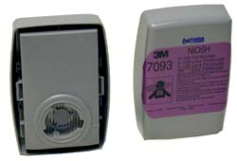
Cartridges
Cartridge life depends on
  Concentration of the contaminant
  User breathing rate and volume
  Humidity in the air
  Other factors
Do not use smell as an indicator of breakthrough!

Slide 7
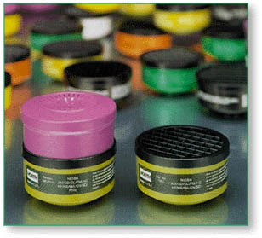
Cartridges
Filters/Cartridges are color coded
  Organic vapor (OV) -- black
  Particle filter (HEPA) -- purple
  Acid gas -- yellow / white
  Ammonia -- green
DO NOT “mix-and-match” respirator components--ILLEGAL!

Slide 8
Responsiblities
All Hands
  Fully complete the medical evaluation questionnaire
  Get fit tested
  Inspect respirators before and after each use
  Perform positive & negative seal checks prior to each use
  Report malfunctions to supervisor
  Prevent damage or loss to respiratory equipment

Slide 9
Medically Qualify
Some medical problems may prevent wearing respirator
  Respiratory, cardiovascular diseases
  Physical deformities
  Medications
  Neurological problems
  Psychological conditions

Slide 10
Fit Testing
Respirators exist in variety of styles, shapes, sizes
  Half and full facepiece respirators come in small, medium, and large sizes
  Each user must be tested in the mask they will use
  Fit testing conducted by trained individual to ensure respirator does not leak

Slide 11
Positive & Negative Fit Checks
Required every time respirator is donned.
Positive Seal Check
  Cover exhalation valve and breathe out slightly
Negative Seal Check
  Cover inhalation valve/cartridge and inhale
Mask should not leak around face seal

Slide 12
Wearing a Respirator
Wearing of spectacles, corrective glasses, face shields, goggles, or other eye/face protection equipment shall not interfere with the seal of the facepiece to the face.
Facial hair is prohibited!

Slide 13
Cleaning & Maintenance
Inspection
  All reusable respirators shall be routinely inspected before and after each use
  Missing parts renders a respirator useless
Store in zip-lock bag
Keep away from heat or strong chemicals
Keep in cool dark place

Slide 14
Questions?

